Slide 1
Project Updates
Conflict Group Project 1

Slide 2
Summary
Ran 5 ssp scenarios - every other parameter is reference
GCAM/Cluster issues
Disc Quota Exceeded error (Maggie and I) - any way to get more space?
Error in packages means I need to rebuild GCAM every new time I run it- any ideas for why this happens?
RGCAM working the best to query output databases
Figured out how to query multiple parameters
Next steps: stop GCAM for a bit to determine final metrics

Slide 3
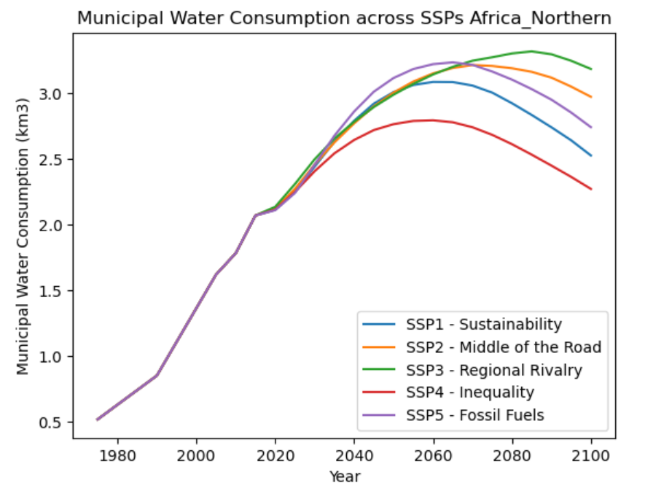
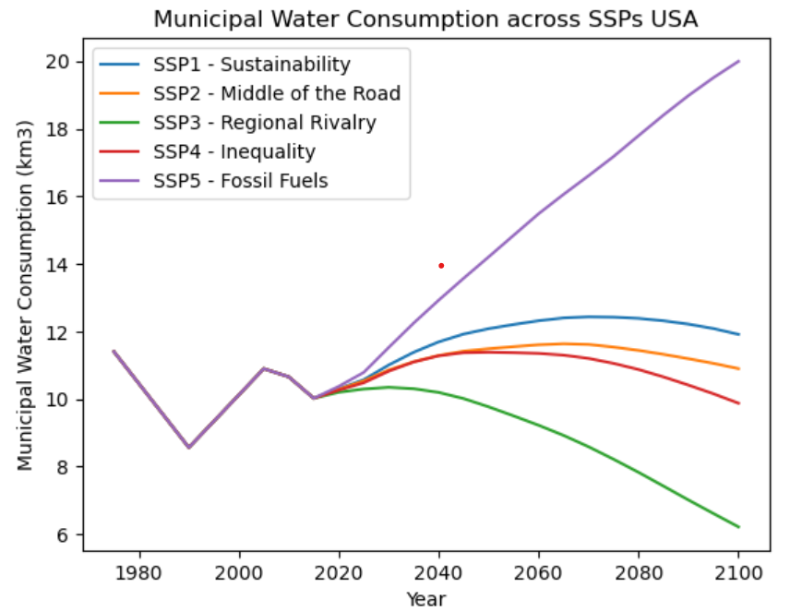
SSPs in Various Regions (Municipal Water Consumption)

Slide 4
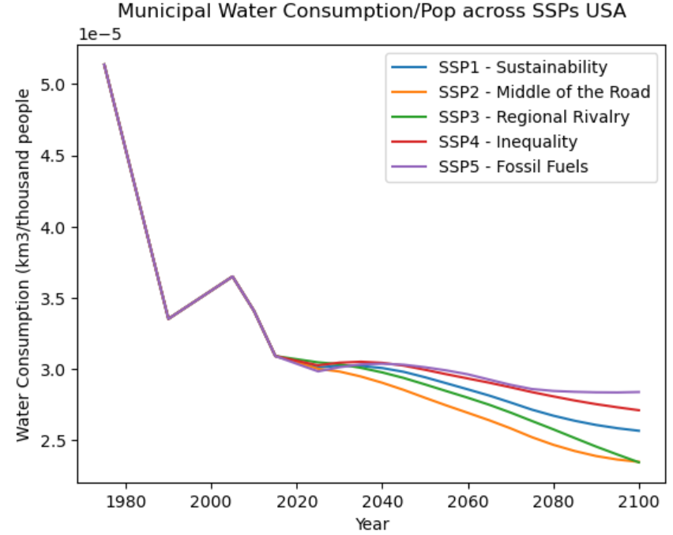
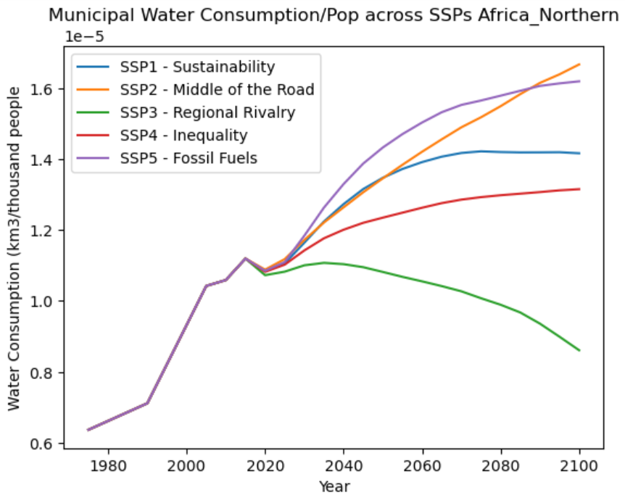

Slide 5
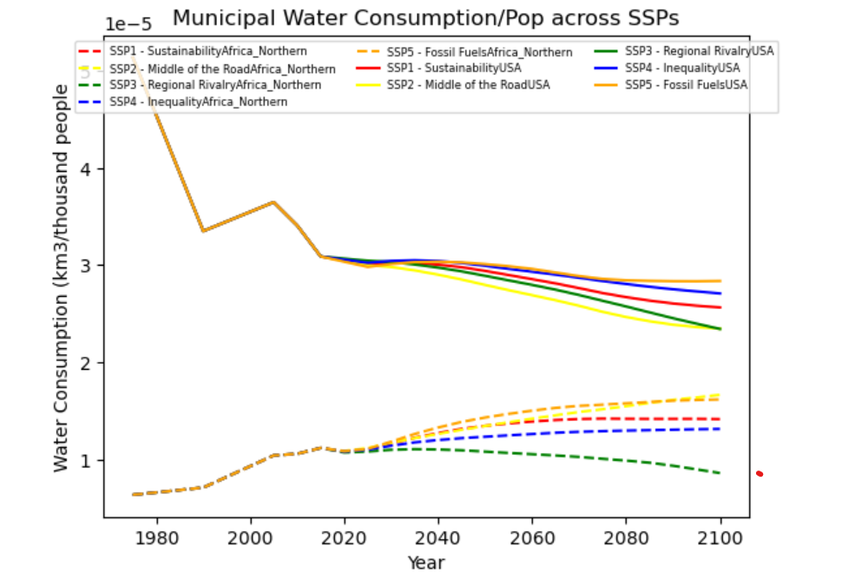

Slide 6
3/5/2024

Slide 7
Goal: Mun Water Consumption per SSP- What early signs can we see?

Slide 8
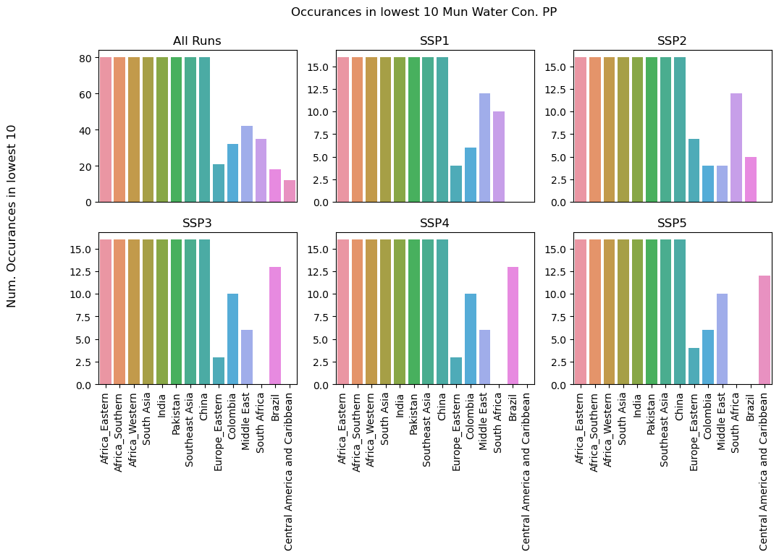

Slide 9
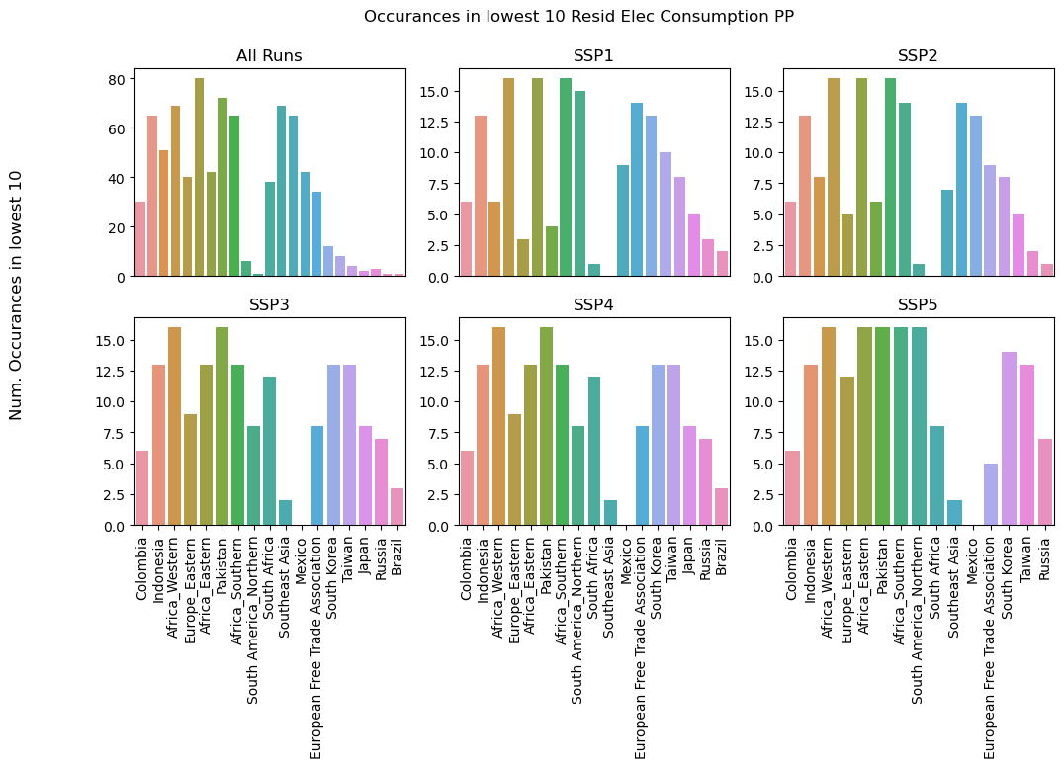

Slide 10
Water
Residential Electricity

Slide 11
3/12/2024

Slide 12
Questions
Update on cluster storage?
Use our own databases or borrow someone else’s given storage limitations?
If others, how to get access?
If our own - how many should/could we run?
Each scenario output is about 3 GB

Slide 13
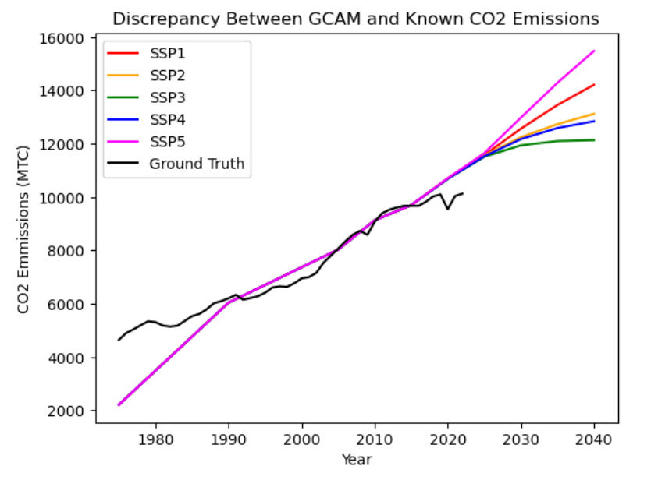

Slide 14
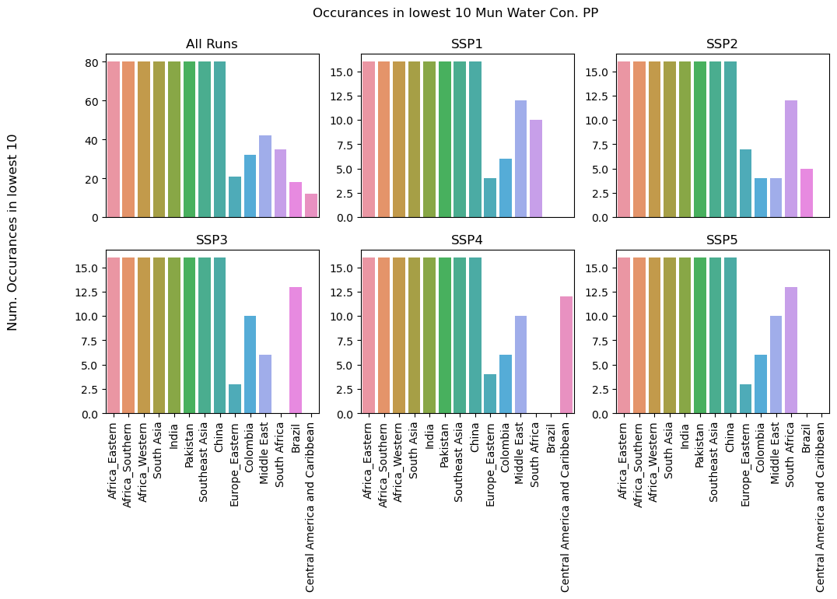

Slide 15
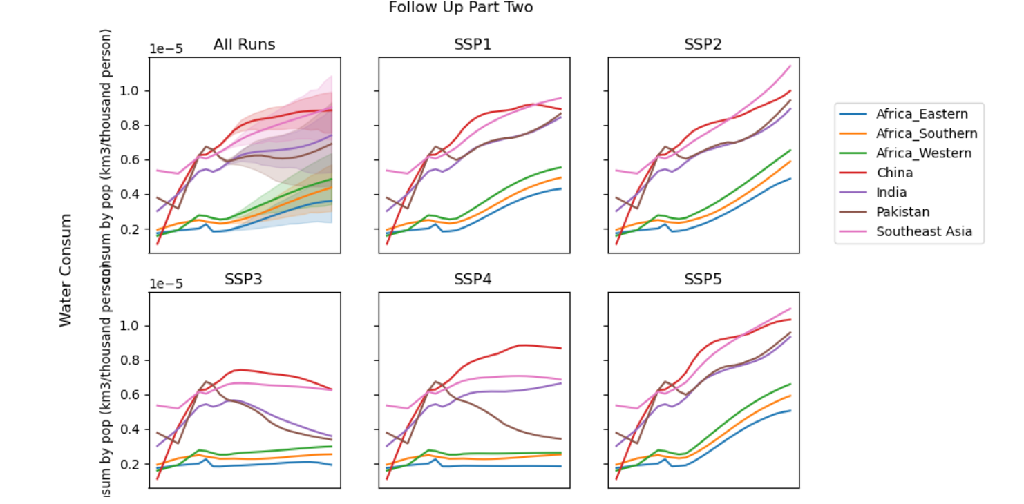

Slide 16
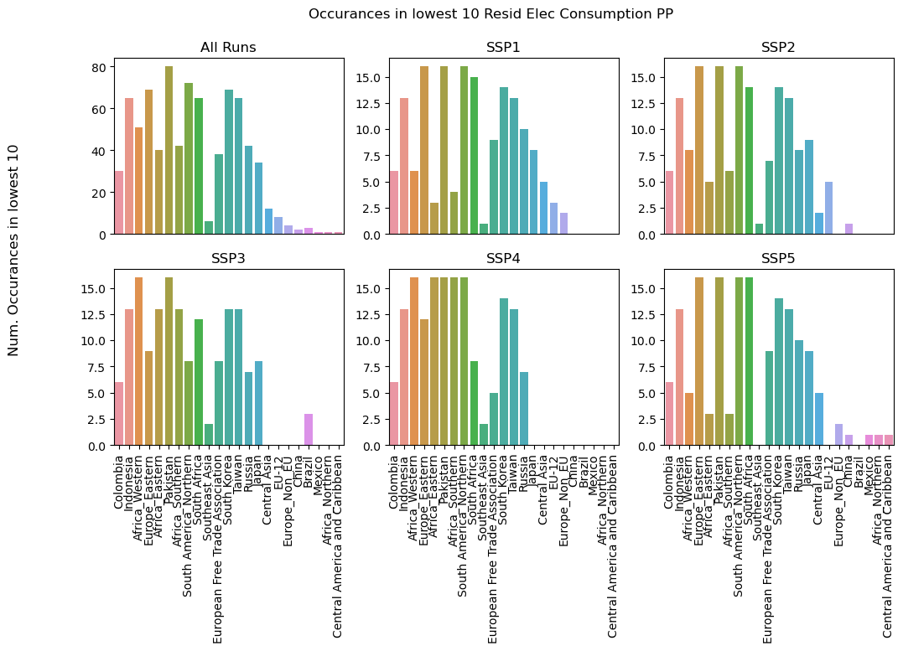

Slide 17
What is a successful presentation?
Two groups should each have their own mini presentations
Maybe other groups could go on as well
Time is up to us - Abani isn’t sure yet
Case for D3M external committee
Some about D3M/PFI overall and conversations about it?
Need example to push classes
Alt. Organization -
IAMs + Critiques
Role of Models
Challenges of these models
Could we cover this to some extent?
Tap Ymbar for this?
Start on the use of IAMs
Then, given the shortcomings, what can be done with IAMs?
Bottlenecks don’t mean give up - it is the best alternative? Lack of data doesn’t stop decision making
Role of models in decision making/planning/negotiation
Key takeaways handout

Slide 18
Conflict Project

Slide 19
Validation Check- CO2 Emissions

Slide 20
Motivation
FEW systems can be linked to increased risk of political insecurity and conflict
Can GCAM demonstrate under what conditions some of these indicators co-locate, indicate an increased risk of conflict?

Slide 21
Step 1: Prove that there is variation in these parameters?
Maybe the middle 50% is the most interesting
The extremes always show up

Slide 22
4/2

Slide 23
Goals this week:
1) Investigate some of the previous issues I had
2) What are some ways of generating figures for GCAM?
3) Explore possible indicator list for alignment to Pardee Rand

Slide 24
Previous Issues

Slide 25

Do SSPs affect the ‘most water scarce’ areas equally?

Slide 26
Municipal Water Follow-up- Where is less than 25 L pp pd?
In 2100, in all 4 scenarios, just Africa
Africa East
Africa Southern
Africa West
South African
Patterns continue to indicate municipal water use may be incorrect withdrawal
However, the 50 L pp pd metric showed a wider range of location

Slide 27
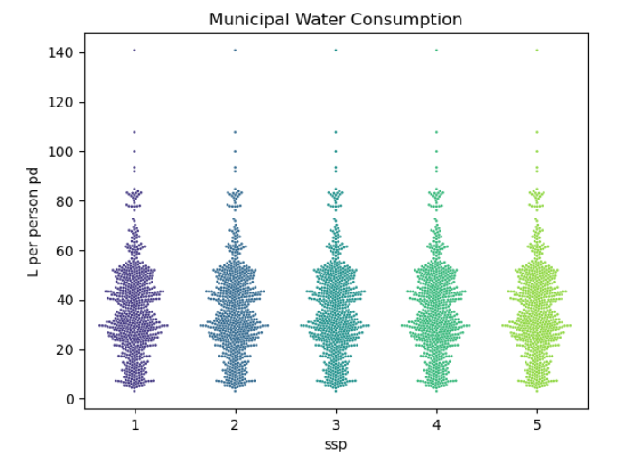
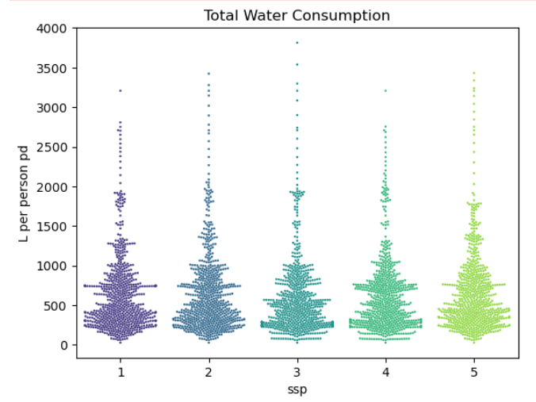
Total water consumption has much more variety in outputs than municipal demand in the 5 scenarios- both could be combined?

Slide 28
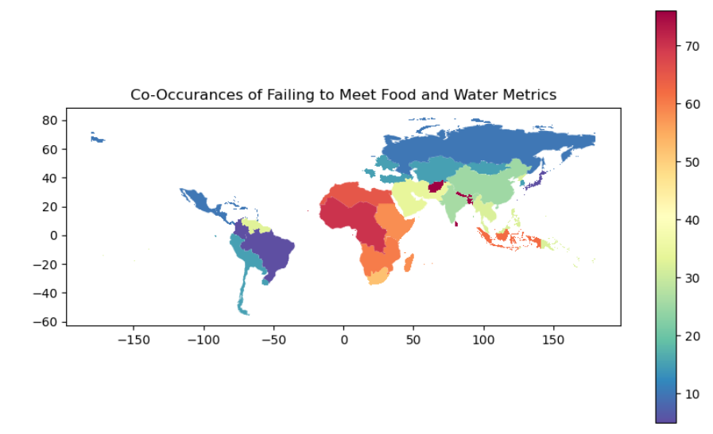

Slide 29

Food Indicators
“Share of Dietary Supply from Nonstarchy Foods—This indicator is calculated as the energy supply (in kilocalories per capita per day) provided by all foods except cereals, roots, and tubers divided by total dietary energy supply (also in kilocalories per capita per day).”
Representation with non-staple food group???

Slide 30
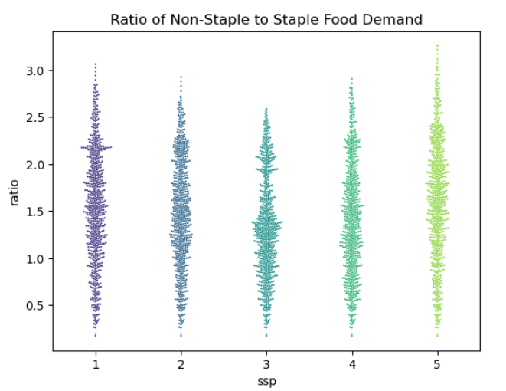

Slide 31
Three indicators- where do these appear and do they align with expectations?
Original test -> water/pp/day / 50 + ratio nonstaple/staple
Gets units around the same area

Slide 32
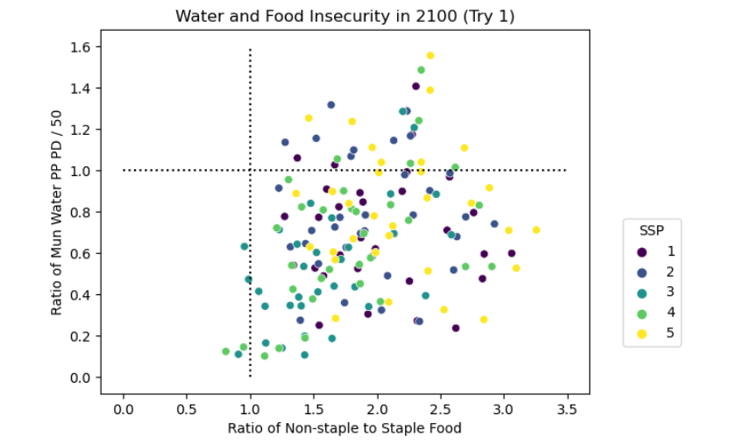

Slide 33
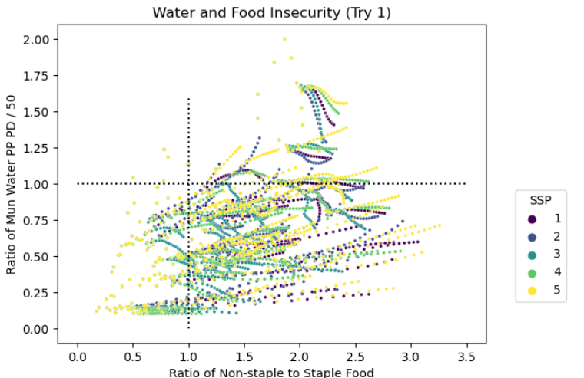

Slide 34
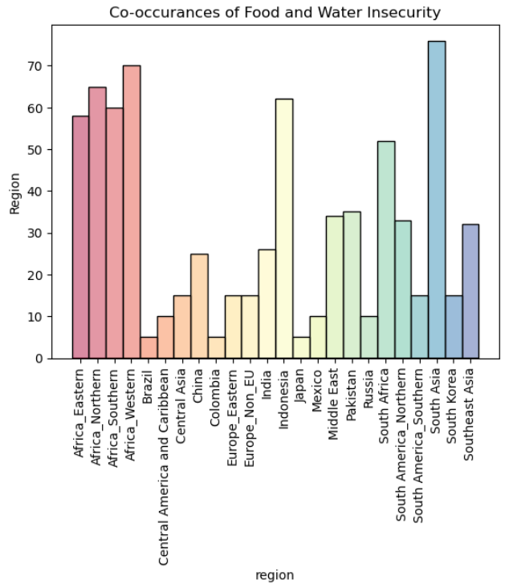
All SSPs, all Time

Slide 35
Index: Food
What is in the index?
Food
Domestic Food Price Level Index (food purchasing power/normal purchasing power)
Share of Dietary Supply from Nonstarchy Foods
Supply of daily dietary calories Relative to Minimum Dietary Requirement
Energy
log of per capita electricity to the log of the per capita electricity consumption required to meet basic needs
Geometric mean of percentage of population with access to electricity and percentage of population using modern fuels for cooking and heating.
Water
country-wide total water withdrawals for municipal uses with the country-wide water requirements for basic municipal purposes. (50 L per day) *some normalization
proportion of the population that uses an improved source of drinking water and the proportion of the population using improved sanitation facilities.
For adaptive capacity, we evaluated the total per capita internally available renewable water.
What can we do with GCAM?

Slide 36
Pardee | GCAM
Domestic Food Price Level Index | Price staple foods/GDP per capita
Share of Dietary Supply from Non-starchy Foods | Supply nonstaple to staple
Supply of daily dietary calories Relative to Minimum Dietary Requirement | Supply to some baseline per person
log of per capita electricity to the log of the per capita electricity consumption required to meet basic needs | Can this be done?
Geometric mean of percentage of population with access to electricity | Amount of electricity?
percentage of population using modern fuels for cooking and heating. | Traditional Biomass/total energy
total water withdrawals for municipal uses with the country-wide water requirements | Working on this
proportion of the population that uses an improved source of drinking water and the proportion of the population using improved sanitation facilities. | Not applicable
total per capita internally available renewable water. | Should be doable

Slide 37
For more methodology, details on truncation, normalization:
https://www.rand.org/content/dam/rand/pubs/tools/TLA2900/TLA2942-1/RAND_TLA2942-3.pdf

Slide 38
Caveats
FEW-Nexus insecurity does not always lead to conflict
Some studies suggest water scarcity might even be an incentive for cooperation

Slide 39
MATH

Slide 40
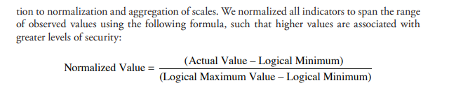

Slide 42
Individual Indicators

Slide 43
Food indicators

Slide 44
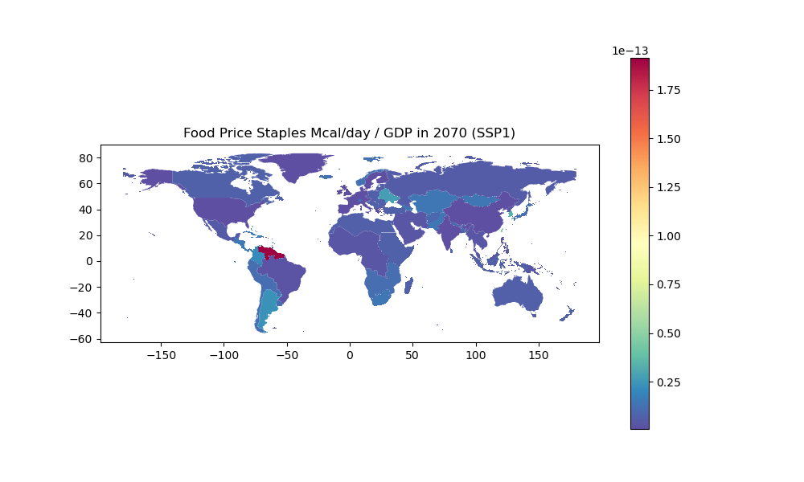
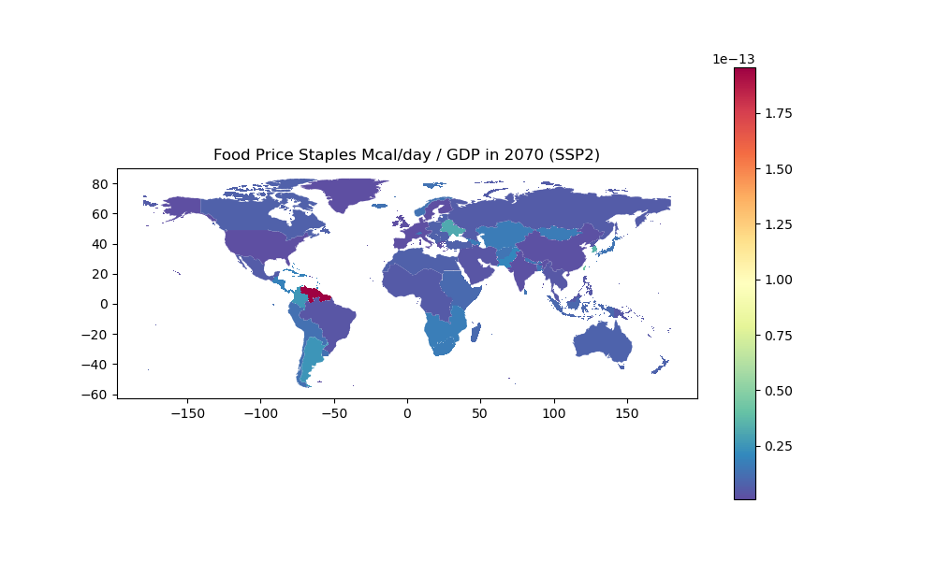

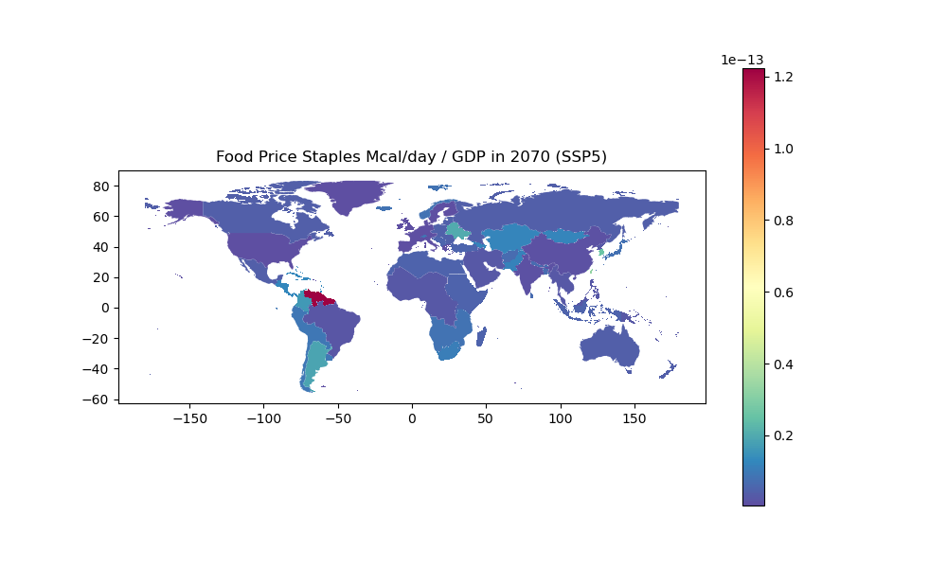
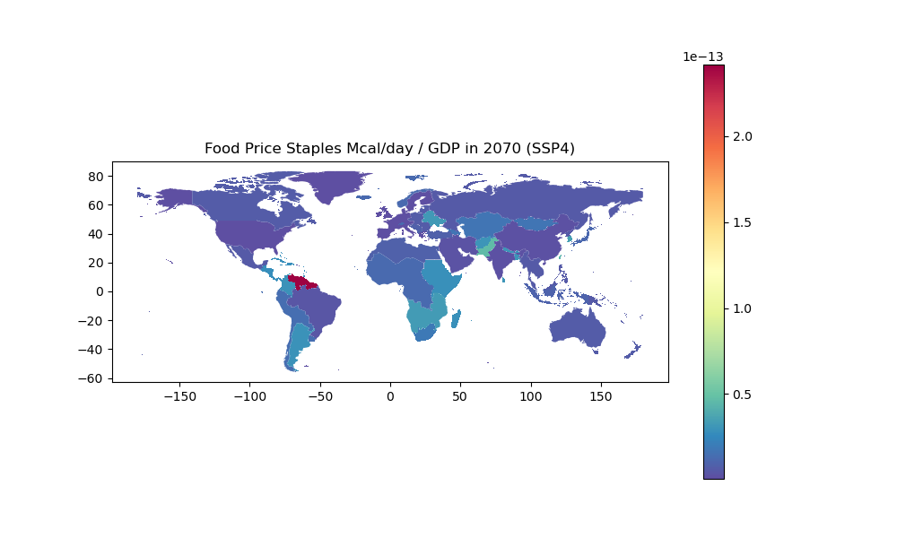
Food Cost Burden (> 1 Bad)

Slide 45
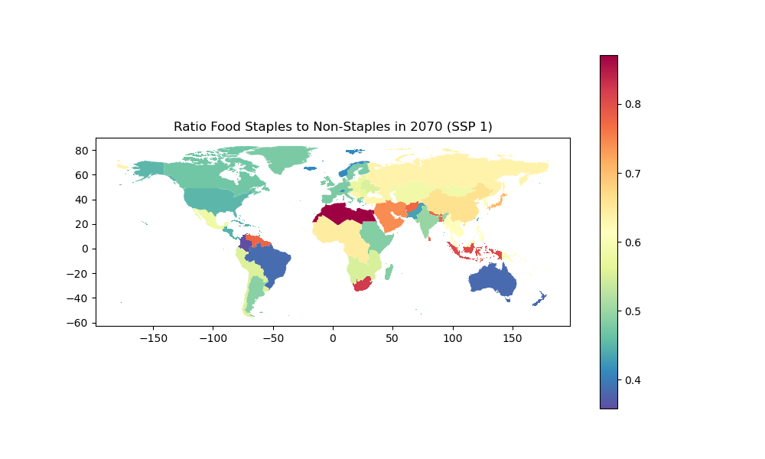
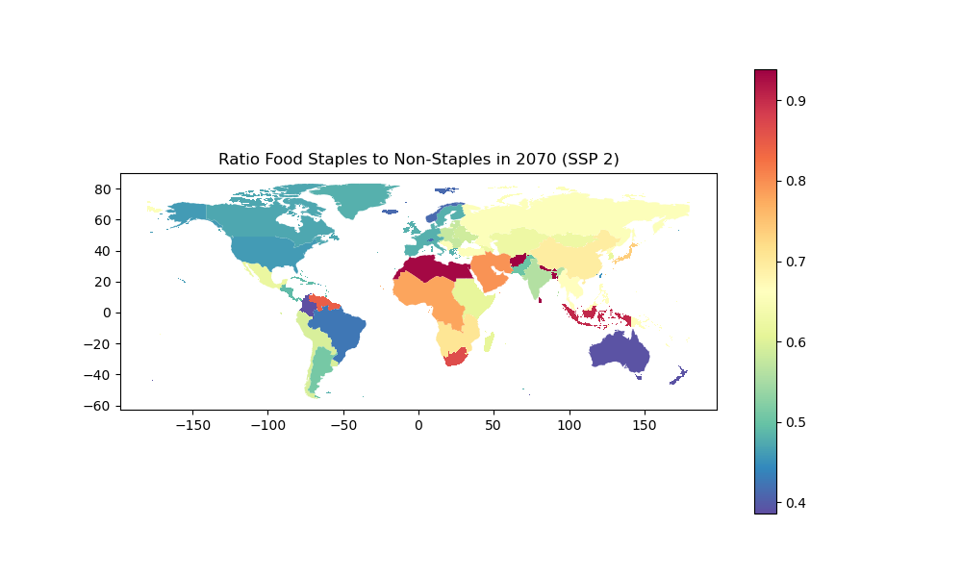
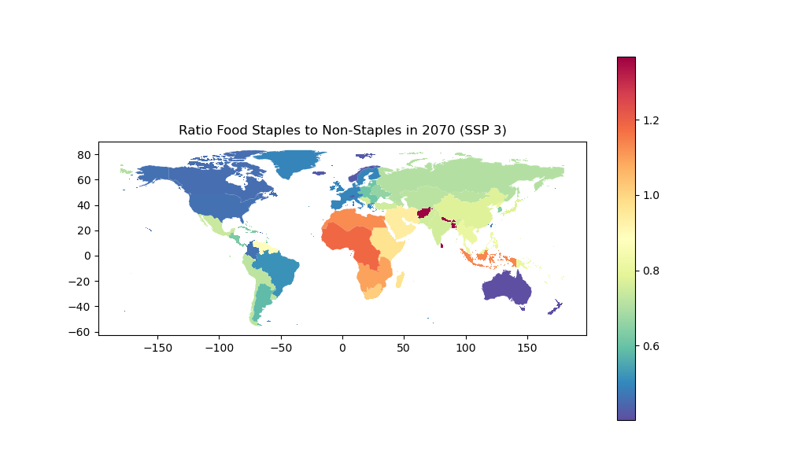
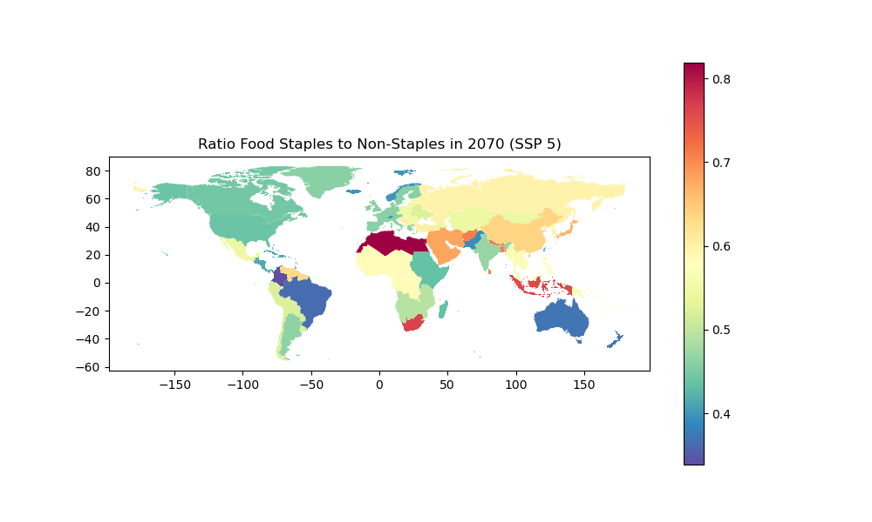
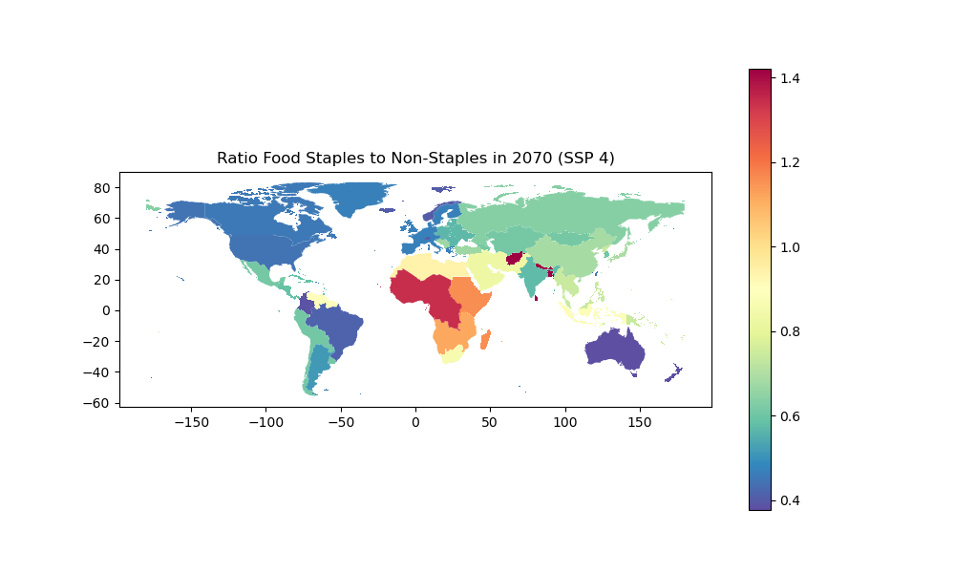
Ratio Food Staples to Non Staples (> 1 bad)

Slide 46
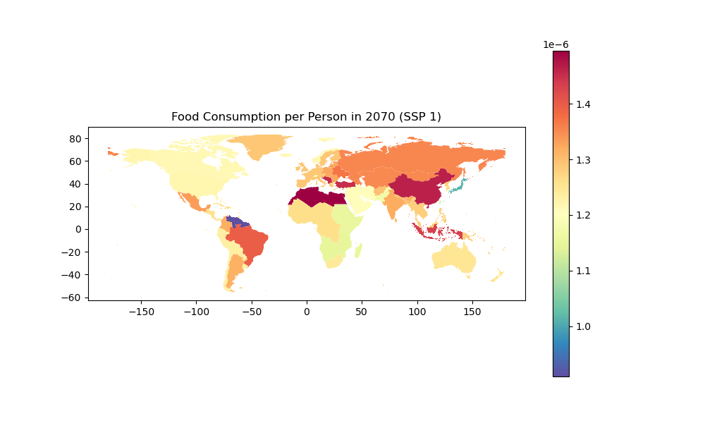
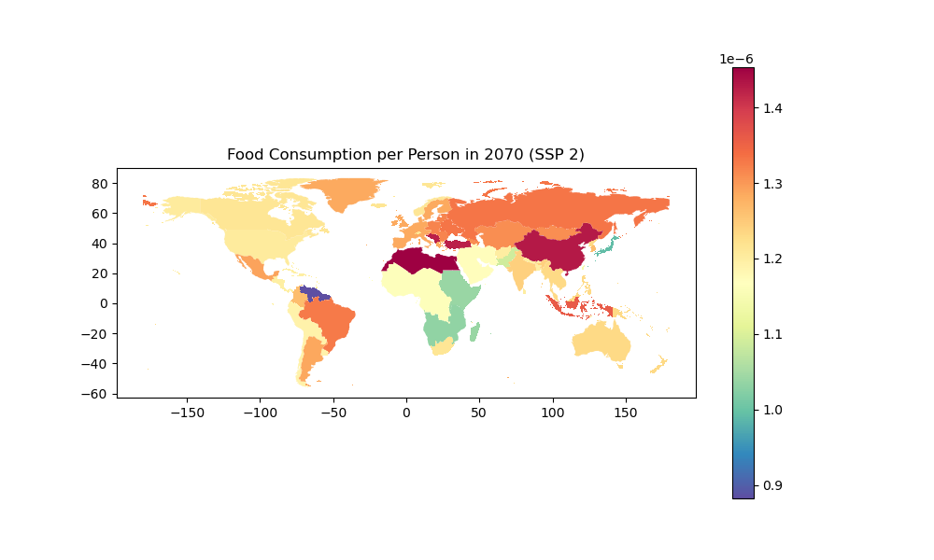
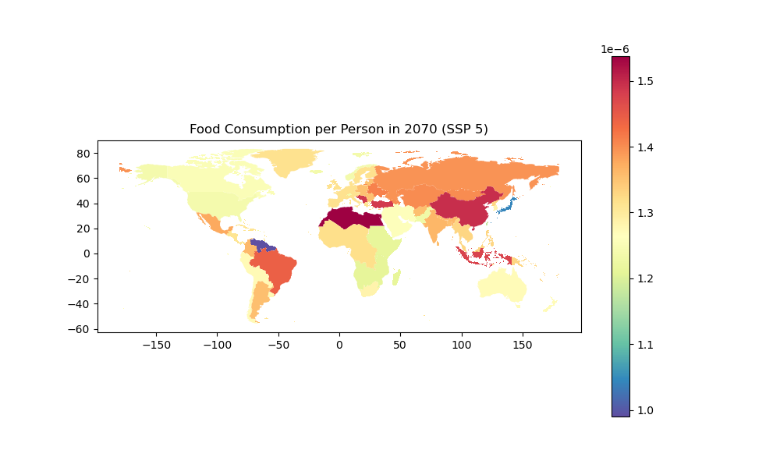
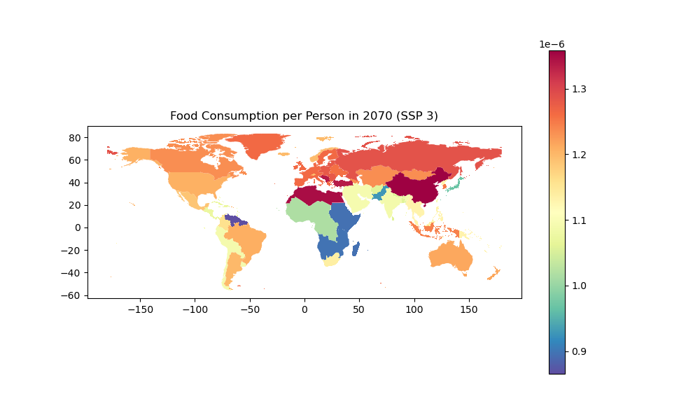
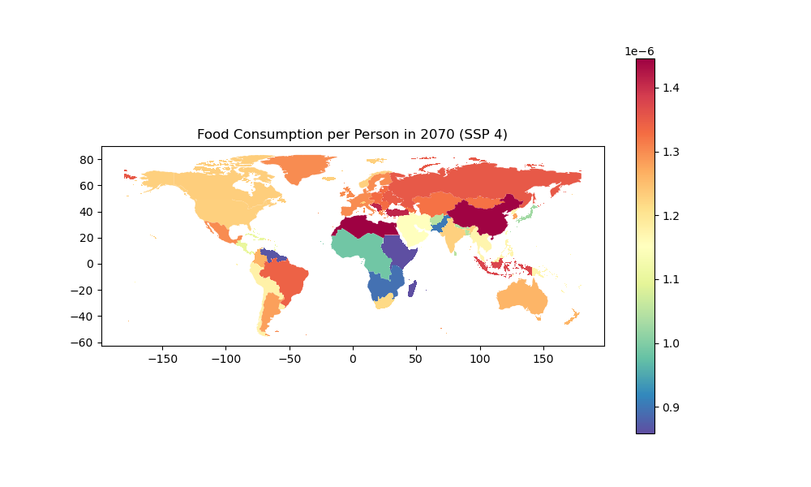

Slide 47
Energy Indicators

Slide 48
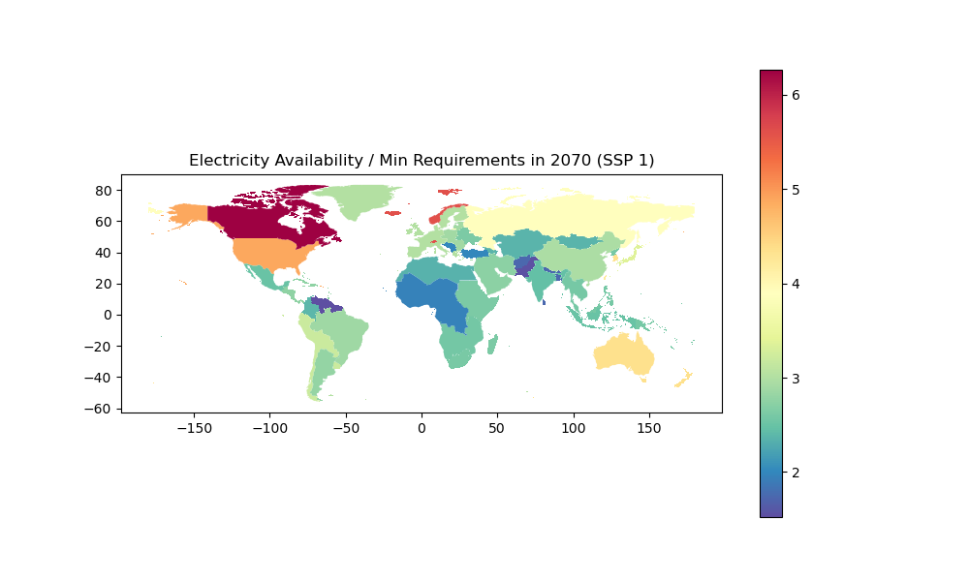
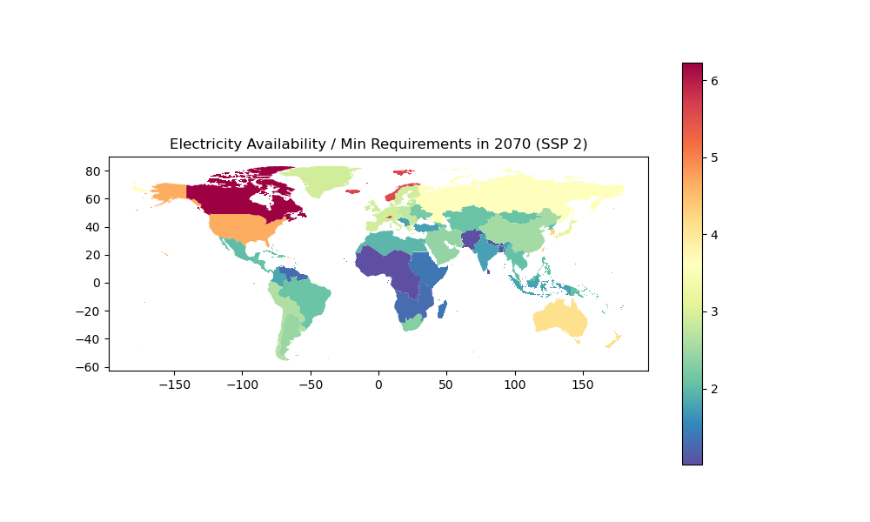
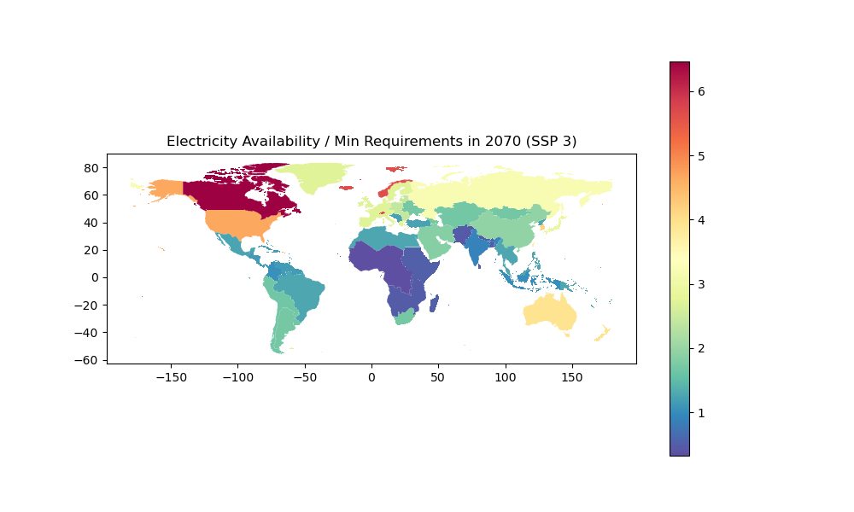
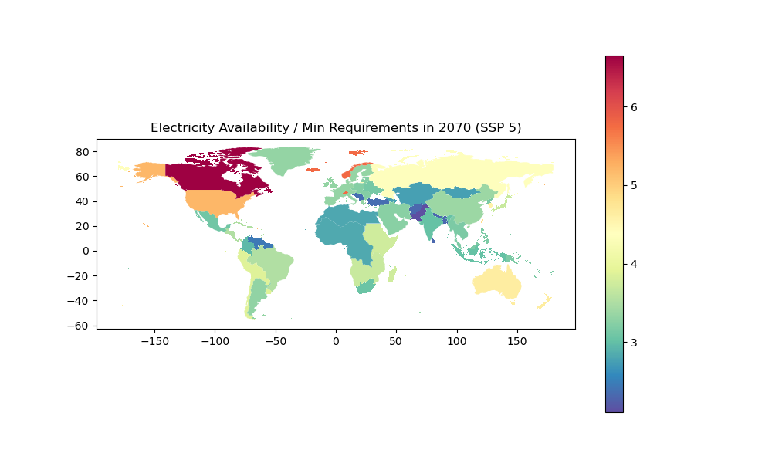
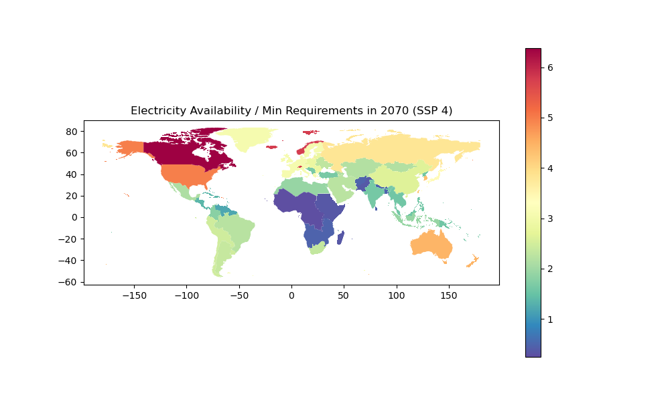

Slide 49
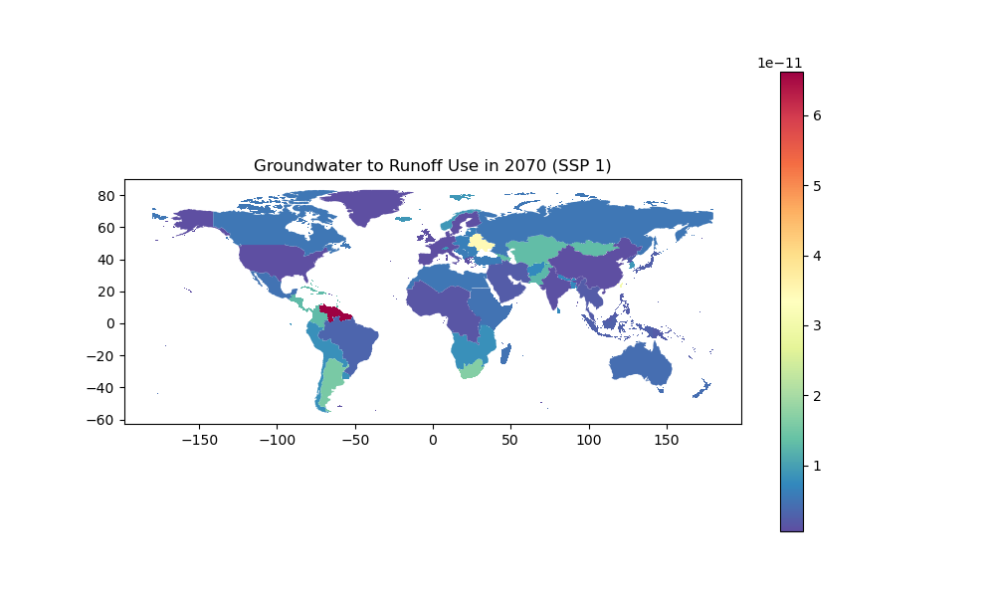

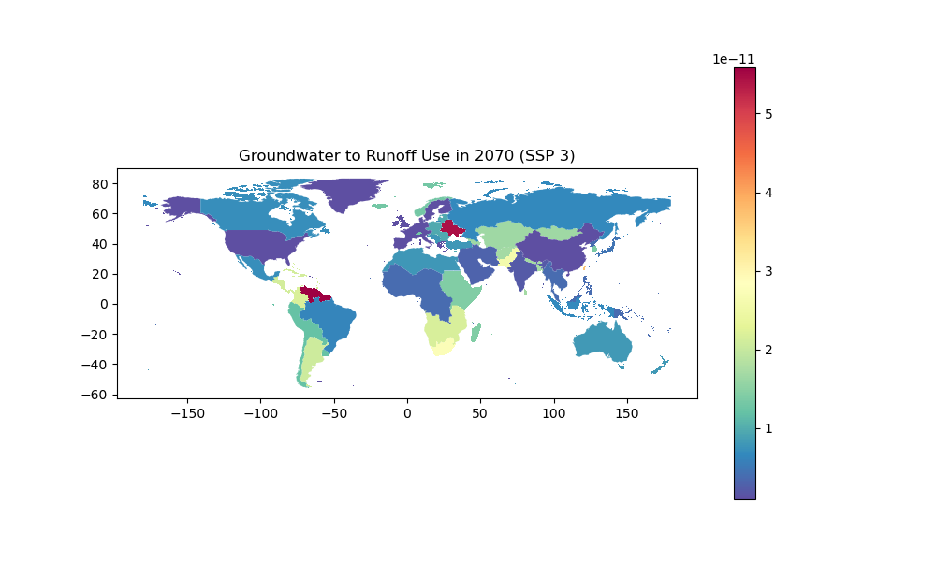
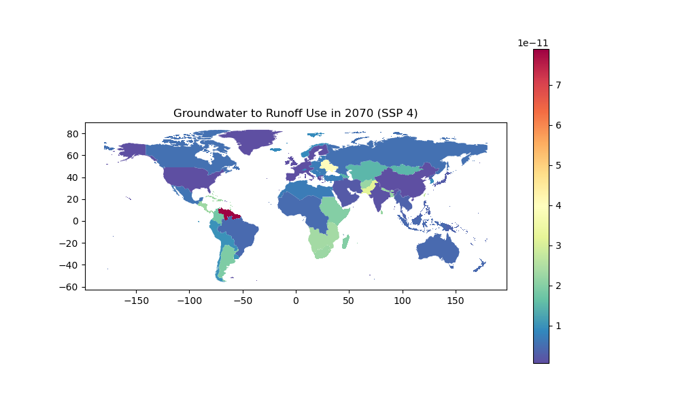
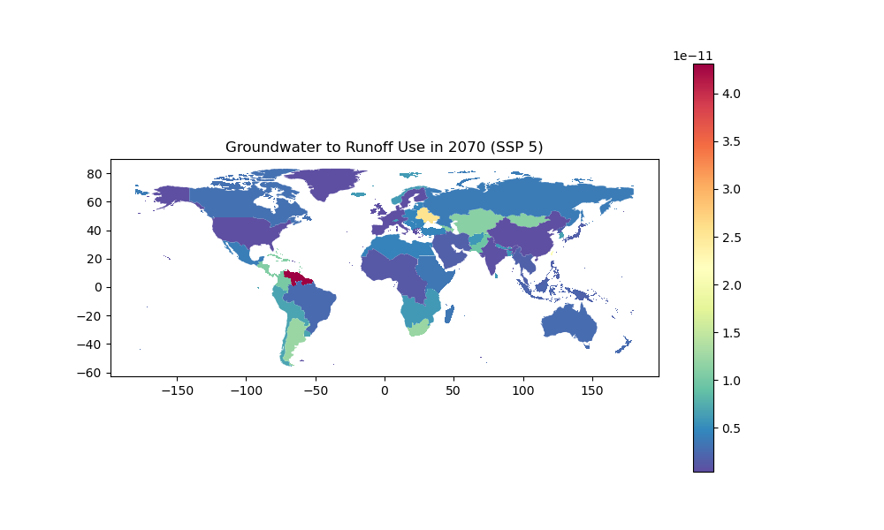
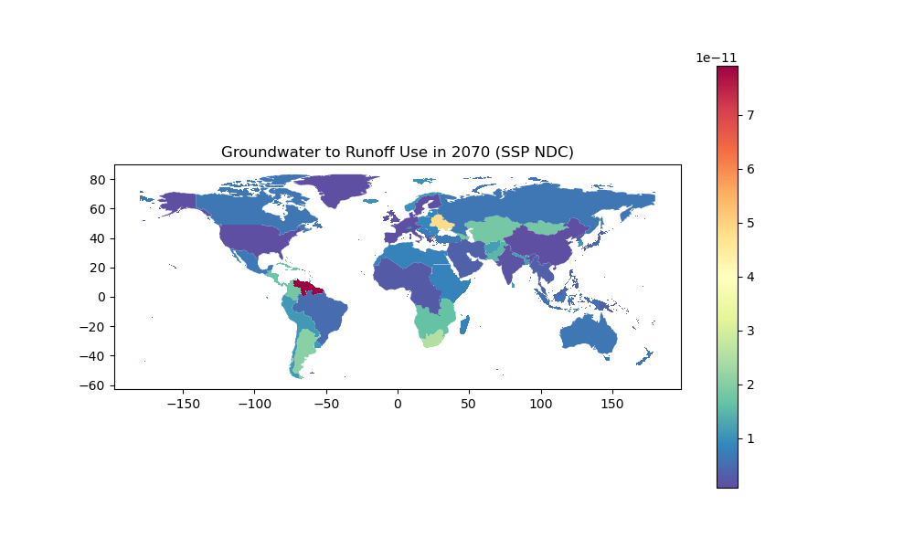

Slide 50
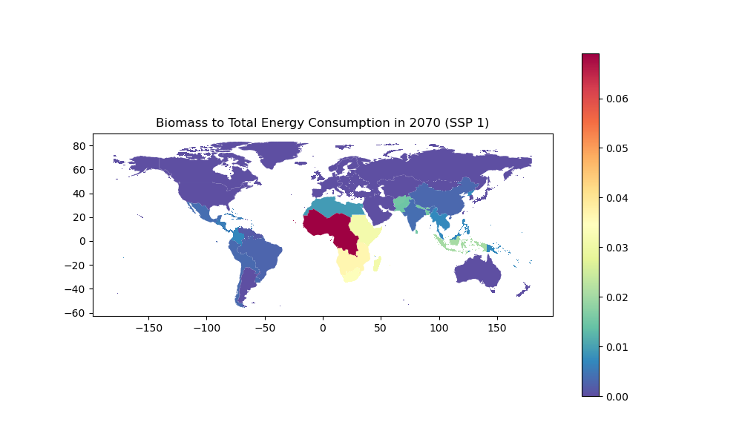
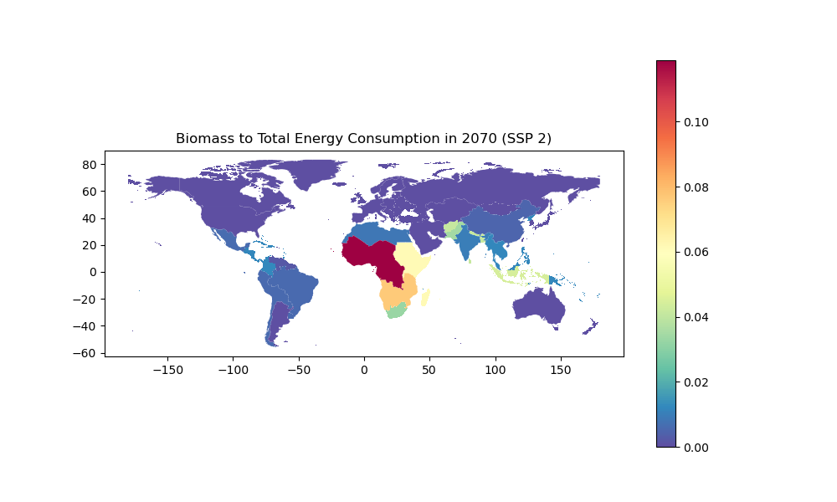
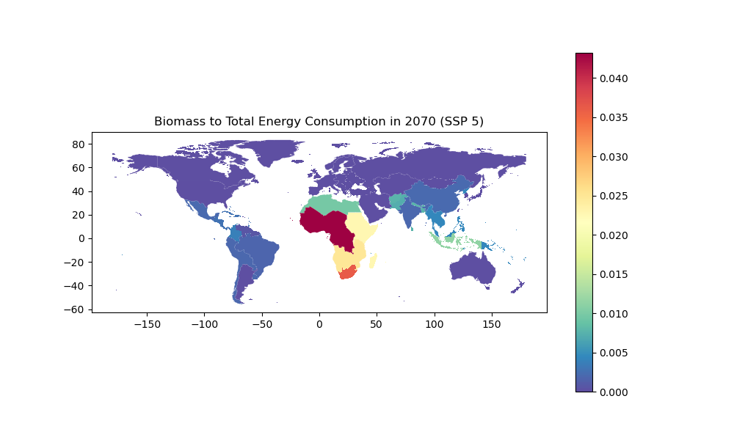
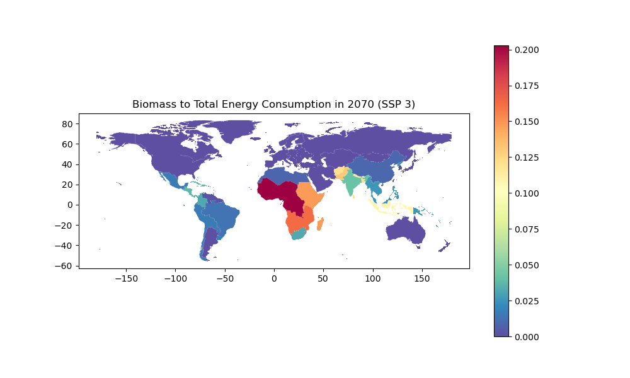

Slide 51
Water Indicators

Slide 52
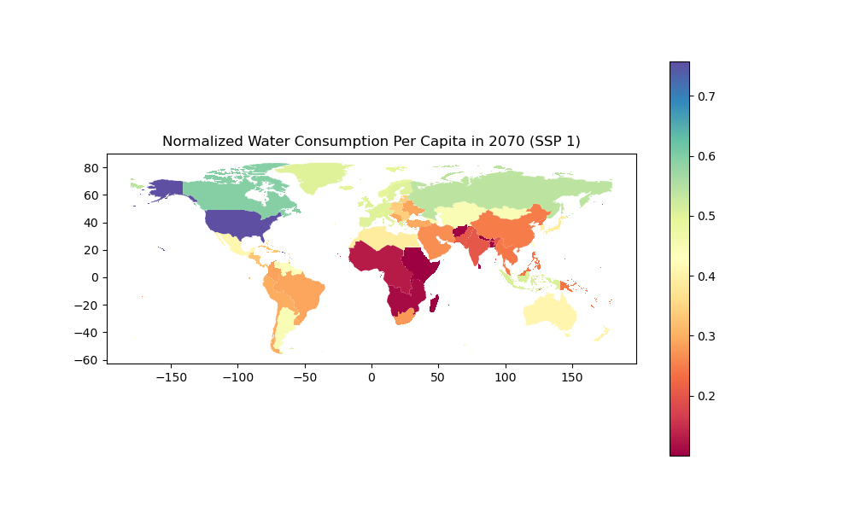
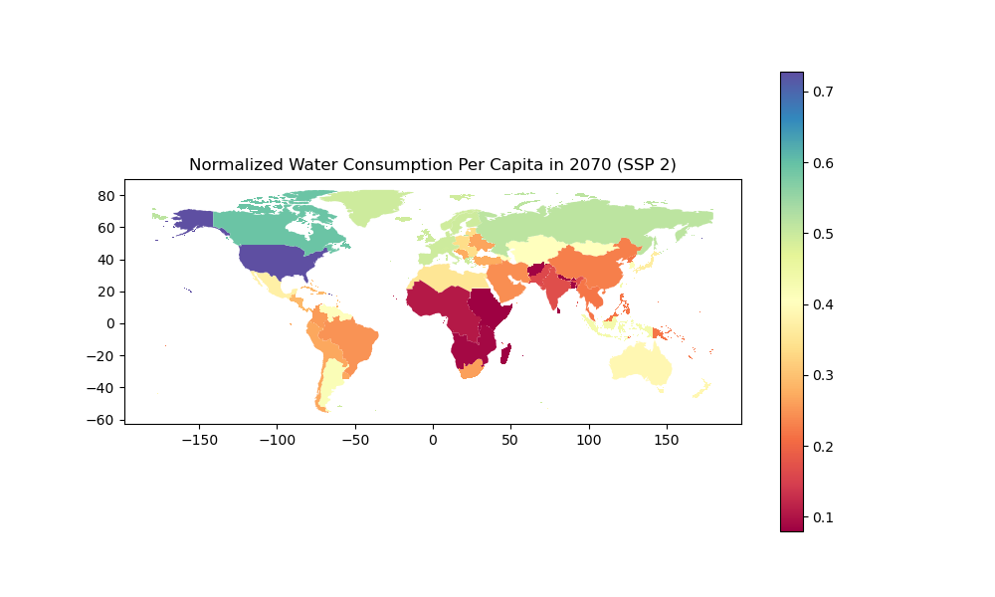
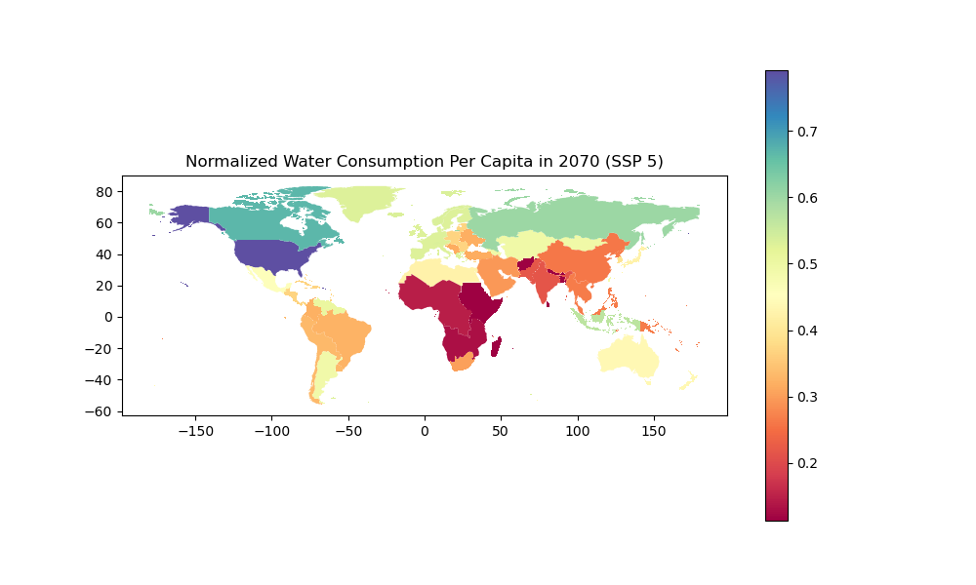



Slide 53






